Slide 1


DROWSINESS DETECTION SYSTEM
TU2F1920036 Rohit Barhate
TU2F1920034 Darshan Desai
TU2F1920030 Vivek Sharma
TU2F1920020 Yash Bhagwat
Guided
by
Prof. Atul Kadam
Department of Electronics and Telecommunication
Terna Engineering College
2022-23

Slide 2
CONTENTS
INTRODUCTION
LITERATURE SURVEY
SYSTEM DESCRIPTION
FLOWCHART
EXPERIMENTAL SETUP
WORKING
LIMITATION AND CHALLANGES
CONCLUSION
REFERENCES

Slide 3
INTRODUCTION
Drowsy driving a combination of sleepiness and driving or driving while fatigued, result from underlying causes:
Sleep deprivation
Changes in circadian rhythm due to shift work, medications and sedatives.
Consumption of alcohol.
Each year, there is an increase in road accidents involving cars particularly on highways in India. Drowsiness and fatigue conditions are one of the prime factors contributing to road accidents.
The main idea behind this project is to develop a non-intrusive system which can detect fatigue and can issue a timely warning or apply brakes incase the drivers doesn’t respond to the warnings.

Slide 4
LITERATURE SURVEY
Fatigue leads to approximately 40% of crashes, causing both fatalities and injuries. In 2020 there were 131 Thousand reports of car crashes due to fatigue.
Several commercial products have been implemented to counter drowsy driving.
Different methods of detecting drowsiness.
Practical systems such as Drowsi-Cam developed at IIT, DriveAlert+ by DriveRisk are currently in use for detection of drowsiness of driver.

Slide 5
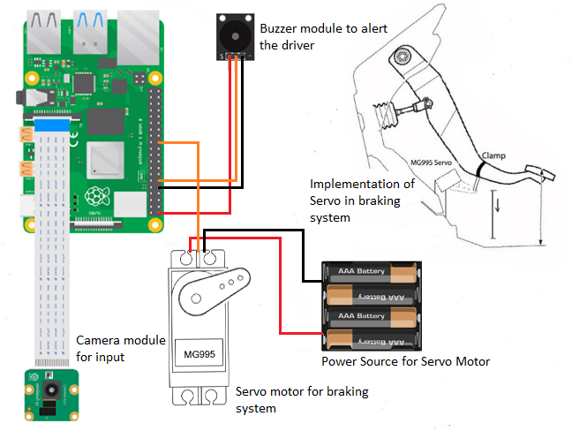
SYSTEM DESCRIPTION
Hardware components used in our project
Software components used in our project
Why we sleeted 40 km/hr as our threshold speed
Why we choose Python over MATLAB.
Selection of face detection algorithm

Slide 6
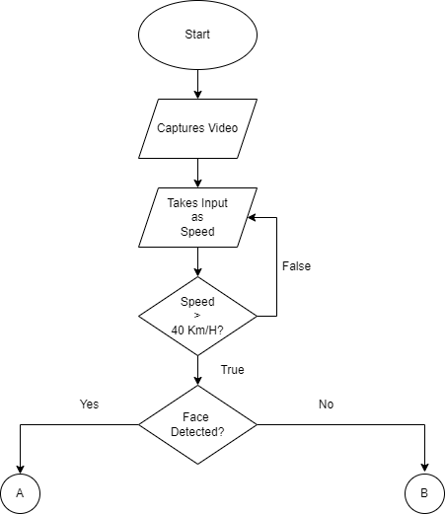
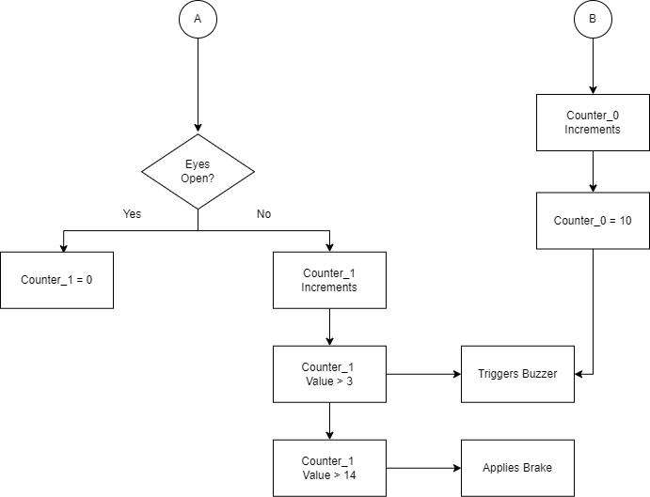
FLOWCHART

Slide 7
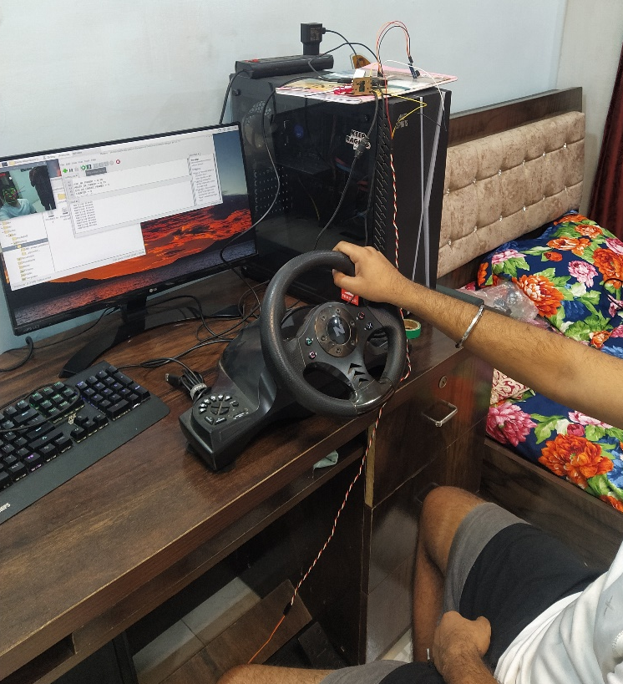
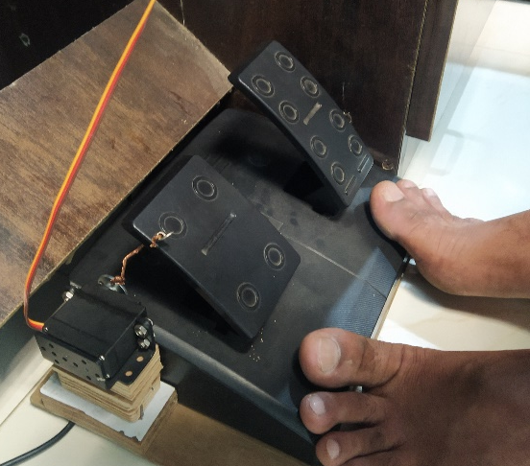
EXPERIMENTAL SETUP

Slide 8
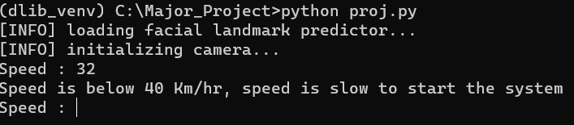
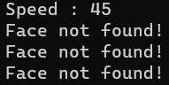
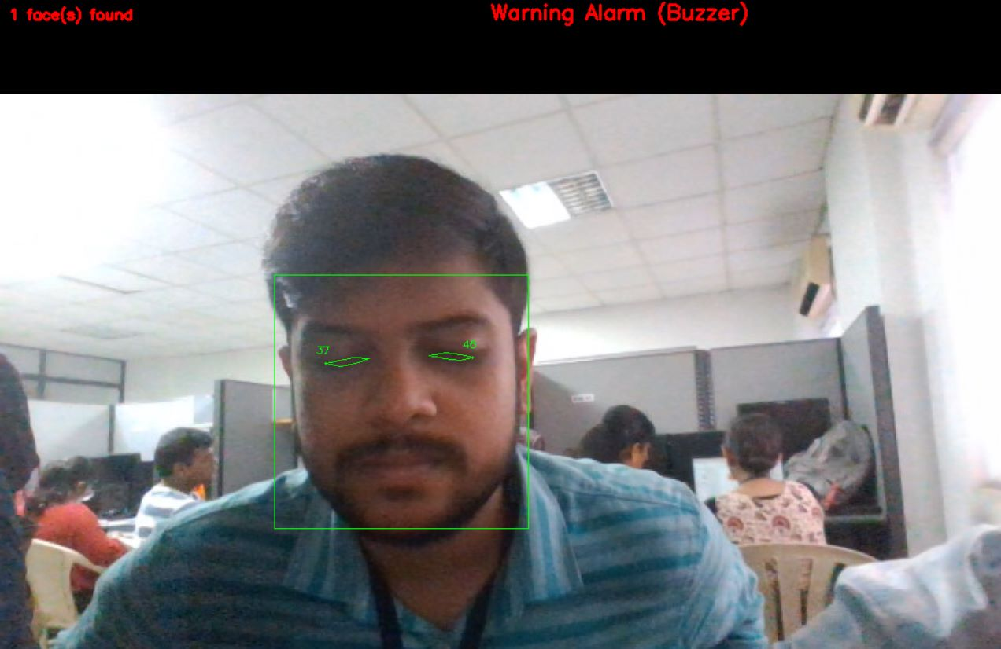
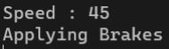
WORKING
When speed is below 40 km/hrs.
When speed is above 40 km/hrs. and face is not found
When drowsiness is detected.
When driver doesn’t wake up to the sound of buzzer

Slide 9
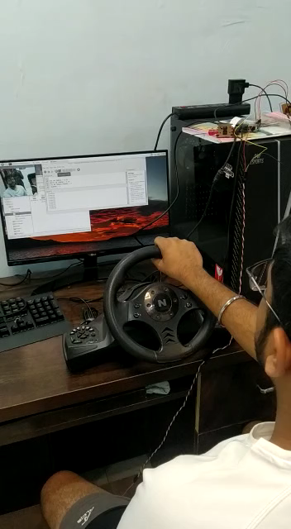
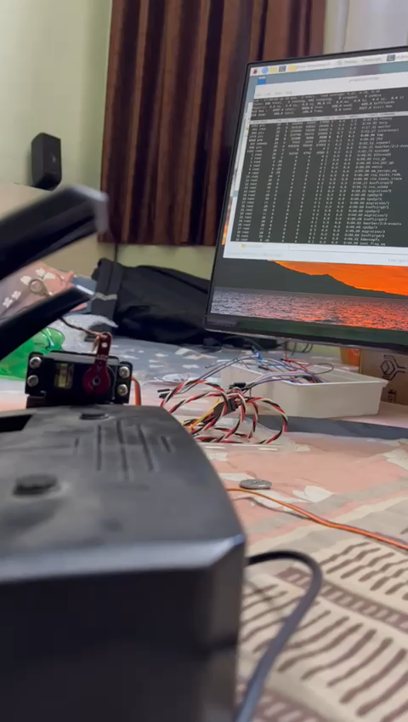
WORKING
Accuracy of drowsiness detection
Key findings and insights

Slide 10
LIMITATIONS AND CHALLANGES
Challenges faced during the project.
Limitations of the system.
Future improvements.
Potential impact on reducing accidents and fatalities
Future applications and extensions of the system

Slide 11
CONCLUSION
Summary of the project
Highly accurate and non-invasive approach for reliable detection of drowsiness without annoyance and interference with the driver was presented
Even with presence of such systems accidents can occur due to poor implementation.

Slide 12
References
R. Grace, V. E. Byrne, D. M. Bierman, J.-M. Legrand, D. Gricourt, B. Davis, et al., "A drowsy driver detection system for heavy vehicles," in Digital Avionics Systems Conference, 1998. Proceedings., 17th DASC. The AIAA/IEEE/SAE, 1998, pp. I36/1-I36/8 vol. 2.
Yan, J.-J., Kuo, H.-H., Lin, Y.-F., & Liao, T.-L. (2016). Real-Time Driver Drowsiness Detection System. Based on PERCLOS and Grayscale Image Processing. 2016 International Symposium on Computer, Consumer and Control (IS3C).
S. Kailasam, M. Karthiga, R. M. Priyadarshini, K. Kartheeban and K. Anithadevi, "Accident Alert System for Driver Using Face Recognition," 2019 IEEE International Conference on Intelligent Techniques in Control, Optimization and Signal Processing
Challenges of Driver Drowsiness Prediction: The Remaining Steps to Implementation (2021) Emma Perkins, Chiranjibi Sitaula, Michael Burke, Member, IEEE and Faezeh Marzbanrad, Senior Member, IEEE
M. Ramzan, H. U. Khan, S. M. Awan, A. Ismail, M. Ilyas, and A. Mahmood, “A survey on state-of-the-art drowsiness detection techniques,” IEEE Access, vol. 7, pp. 61 904–61 919, 2019
X. Hu and G. Lodewijks, “Detecting fatigue in car drivers and aircraft pilots by using non-invasive measures: The value of differentiation of sleepiness and mental fatigue,” Journal of Safety Research, vol. 72, pp. 173–187, 2020
A. Chowdhury, R. Shankaran, M. Kavakli, and M. M. Haque, “Sensor applications and physiological features in drivers’ drowsiness detection A review,” IEEE Sensors Journal, vol. 18, no. 8, pp. 3055–3067, 2018
https://www.ncbi.nlm.nih.gov/pmc/articles/PMC3571819/
https://morth.nic.in/sites/default/files/Road_Accidents_in_India_2019.pdf
https://crashstats.nhtsa.dot.gov/Api/Public/ViewPublication/813337
https://www.globalncap.org/safercarsforindia
http://dlib.net/
https://towardsdatascience.com/face-detection-models-which-to-use-and-whyd263e82c302

